Slide 1
ftwilliam.com
Administration Software
User Group Meeting
Meeting #15 - February 4, 2014

Slide 2
Agenda
ADP/ACP tests and corrections
  Review of tests
  Basic tests
  Advanced tests
  ACP test when after-tax allowed
Vendor updates
New enhancements released
  Delete sources & investments
  Loan module
  Vesting export reports
Open forum

Slide 3
General Overview
Non-safe harbor plans are required to pass ADP/ACP test to show compliance with nondiscrimination rules of 401(a)(4).
If the ADP test and/or ACP test fails:
  Refunds are due within 2 ½ months after end of plan year to avoid excise tax.
  Other correction options, such as QNEC, must be made within 12 months after end of plan year.

Slide 4
Highly Compensated Employees
More than 5% owner in determination year or look-back year
  Family members of 5% owners also considered HCE
Received compensation in excess of threshold in the look-back year
  Threshold for 2013 & 2014 is $115,000
Notes:
Actually paid over the gross compensation limit determined by COLA (see Four-Year COLA Summary and Correct Compensation for Testing section), during the prior plan year (or prior 12-month period, if the prior plan year was shorter than 12 months – also known as the “look-back period”), regardless of the amount of compensation actually paid during the plan year being tested; or
• An owner of more than 5% of a company sponsoring the plan, either during the plan year being tested or the
look-back period; or
• A family member of an over-5% owner.
Note: Certain family members of over-5% owners are treated as having the same share of ownership, under Section 318 of the Internal Revenue Code; this includes the over-5% owner’s spouse, parents, grandparents, and children. For example, the child of an over-5% owner is also considered an over-5% owner, and is therefore an HCE regardless of the child’s compensation.

Slide 5
Using Top 20% Election
Top paid group is the highest paid 20% of non-excludable employees – the following may be excluded:
  Less than six months of service
  Scheduled to work less than 17½ hours per week, or less than six months per year
  Age under 21
  Employees in a collective bargaining unit
  Non-resident aliens with no U.S.-source income
Option is located in “Scrub/Eligibility Parameters”
Notes:
In computing the number of employees in this top-paid 20% group (Top-Paid Group), begin with all employees who were employed at any time during the look-back period, including those ineligible to participate in the plan (and including all employees of other companies in a Controlled Group or Affiliated Service Group). However, the following may be excluded:
Exclusions include:
Employees with less than six months of service by the end of the look-back period; or
• Part-time or seasonal employees scheduled to work less than 17½ hours per week, or less than six months
per year; or
• Employees under 21 years of age as of the end of the look-back period; or
• Employees in a collective bargaining unit (if 90% or more of all employees are union members and union
employees were excluded from the plan); or
• Non-resident aliens with no U.S.-source income.

Slide 6
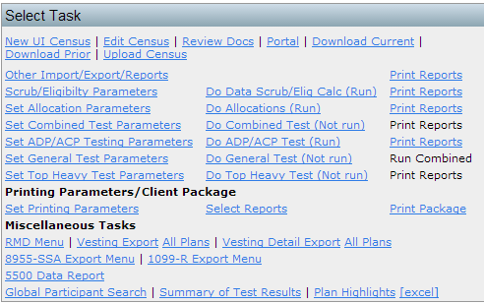
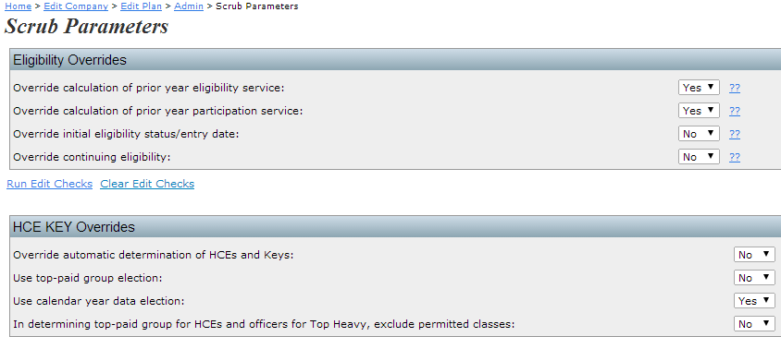
Top Paid Group Election

Slide 7
Allocation Parameters
Having the system calculate Match
  Enter Match formula
    Use whole numbers for percentages (ex. 100% = 100)
  Match allocation manual override = NO
Uploading the Match via the census grid
  Match allocation manual override = YES
  Enter Match formula
    Formula still should be entered so the system can calculate associated match forfeitures and run true-up report

Slide 8
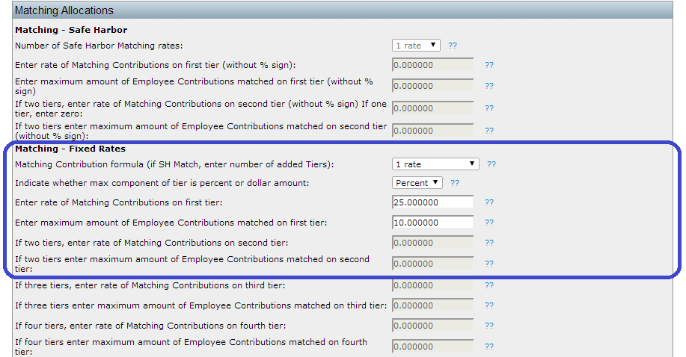
Enter Match formula
Example formula: 25% of compensation up to 10% of compensation deferred.

Slide 9
ADP/ACP Testing – Setting Parameters
Methods to avoid failure
  Borrow contributions from ADR – defaults to Yes
  Create catch-up – defaults to Yes
Failure corrections
  Roth correction order for ADP failures
  Refund income calculation

Slide 10
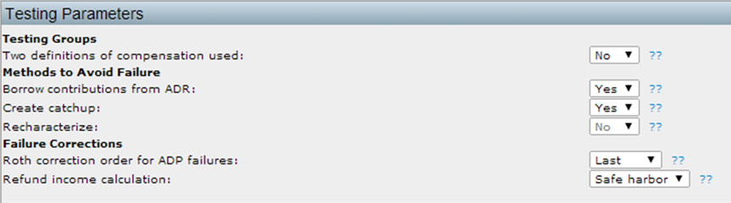
ADP/ACP Test Parameters

Slide 11
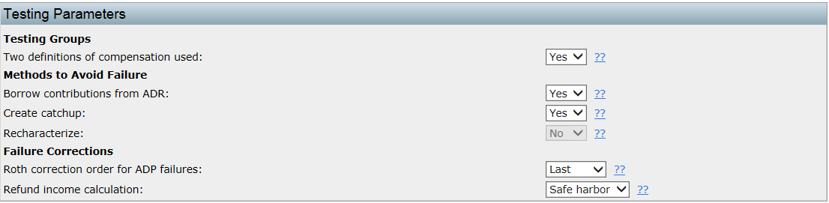
ADP/ACP Failure Corrections
Roth options – how contributions refunded
  Options are first, last or pro-rate
Income options – earnings calculation
  Options are safe harbor, percent or dollar

Slide 12
QNEC Plan Specs/Contributions
Pro Rata
  Plan Specifications – Eligibility: to set for “NHCEs only”
  Plan Specifications – Contributions: to set “Pro-rata” or “Bottom up”
  Pro-rata selection will allocate the QNEC needed to pass the ADP test to non-highly compensated employees, based on their compensation.

Slide 13
QNEC Parameters Setup
Bottom up
  Plan Specifications – Eligibility: to set for “All Participants” or “NHCEs Only”
  Plan Specifications – Contributions: to set “Bottom up”

Slide 14
The ADP & ACP Tests
ADP test compares average deferral rate for HCEs to Non-HCEs
  Pre-tax & Roth deferrals considered
ADP of HCEs may not be more than:
  NHCE ADP x 1.25 or + 2 percentage points and x 2
  Rule of Thumb:
    NHCE ADP is 2% or less – times 2
    NHCE ADP is 2% to 8% - plus 2
    NHCE ADP is more than 8% - times 1.25
ACP test uses match & after-tax contributions

Slide 15
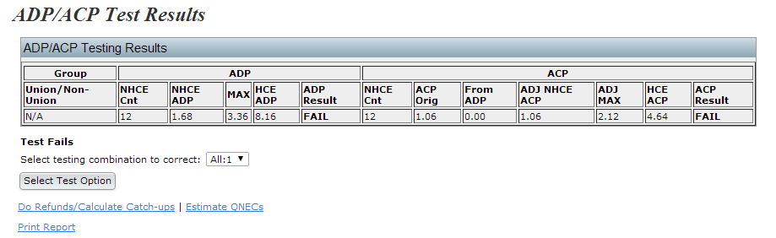
ADP/ACP Corrections (Failing Test)
Select testing combination to correct
Do Refunds/Calculate Catch-ups
Estimate QNECs

Slide 16
Do Refunds/Calculate Catch-ups
When this link is pressed the system:
  Calculates catch-ups due to a failed ADP test
  Prints ADP/ACP refunds (as applicable)
  Prints associated match refunds (if applicable)
Option to “Update ADP/ACP refund earnings with transaction data
  Beginning balance, contributions and earnings batches must be posted and statements run for data to populate.
  The system will pull applicable data then calculate the refund earnings based on the system data.

Slide 17
Estimate QNECs
Clicking Estimate QNECS will provide a system estimate of QNECs needed to pass the ADP/ACP test.
Will allocate a QNEC to eligible participants based on the plan specifications.
Press “Allocate estimated QNECs” to have the system allocate the QNEC. It is then suggested that all tests are rerun and confirm passing results.
Press “Hmmmm – Let’s try something else” to prevent the system from allocating the QNEC.

Slide 18
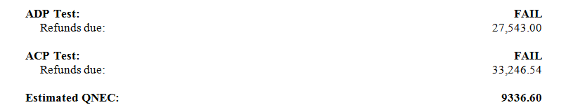
Summary of Test Results
Use this report to show clients the Refunds and Estimated QNEC options.

Slide 19
ADP/ACP Testing – Setting Parameters
Prior year elections
  Need to add in first year using ftw software
    If using disaggregation need to enter all three results

Slide 20
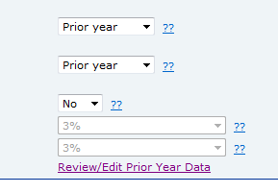
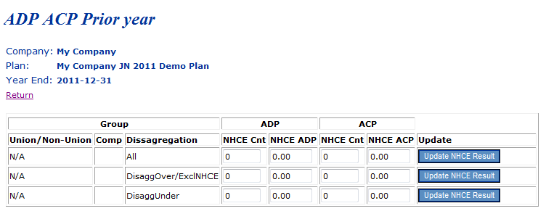
ADP/ACP Testing – Setting Parameters
Using prior year NHCE data

Slide 21
ADP/ACP Testing – Setting Parameters
Using disaggregation of Otherwise Excludable Employees (OEE) – set on Combined Test Parameters screen

Slide 22
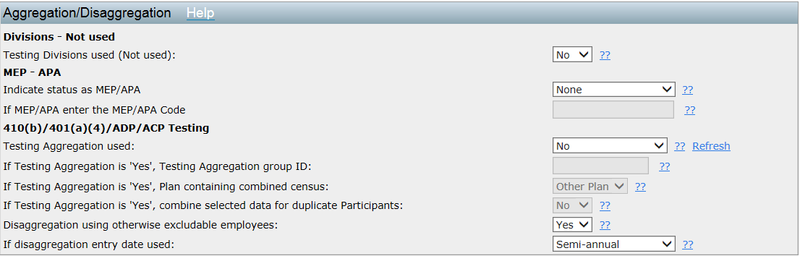
ADP/ACP Testing – Setting Parameters
Combined test Parameters

Slide 23
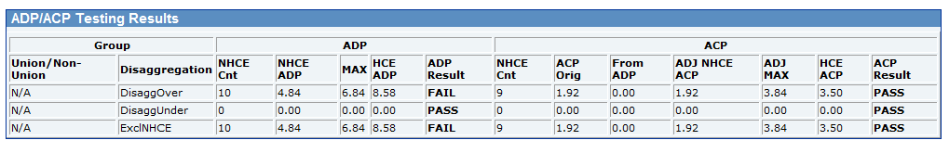
Results Screen
When using disaggregation:
  DisaggOver - shows the test results for the group who are not excludable
  DisaggUnder - shows the test results for the group who do not meet statutory eligibility
  ExclNHCE - shows the results excluding only the NHCEs not meeting statutory eligibility from the test.

Slide 24
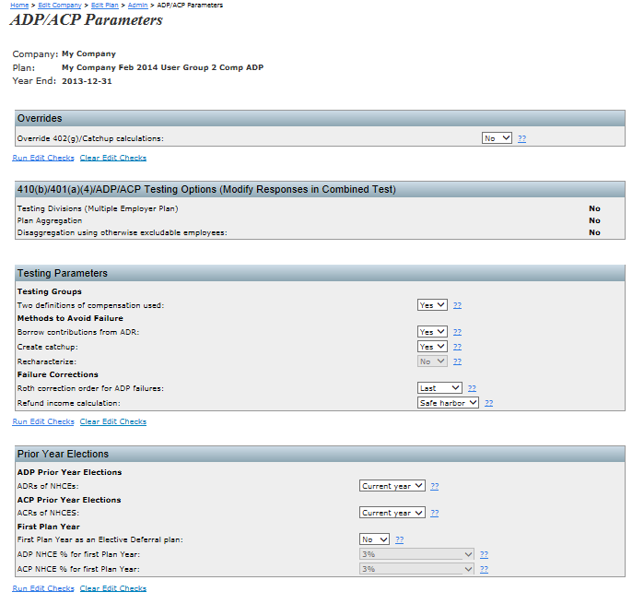
ADP/ACP Testing – Setting Parameters

Slide 25
ADP/ACP Testing – Setting Parameters
Using two definitions of compensation
  What compensation do you want to use?
  Set on census grid
  Check mapping

Slide 26
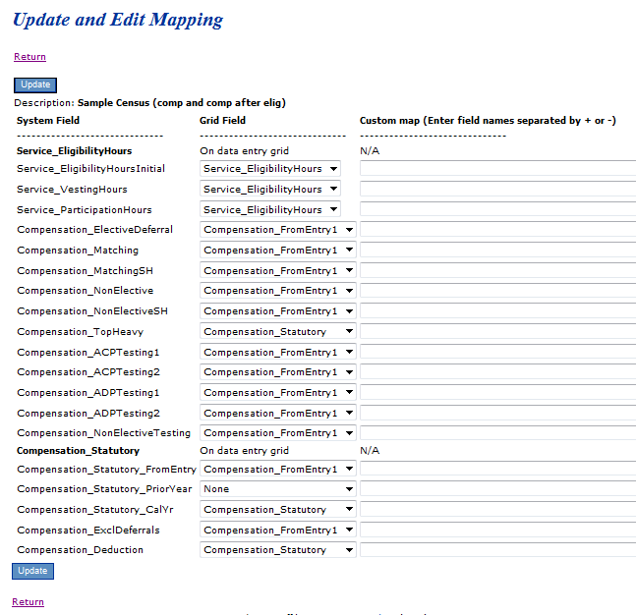
Check grid mapping

Slide 27
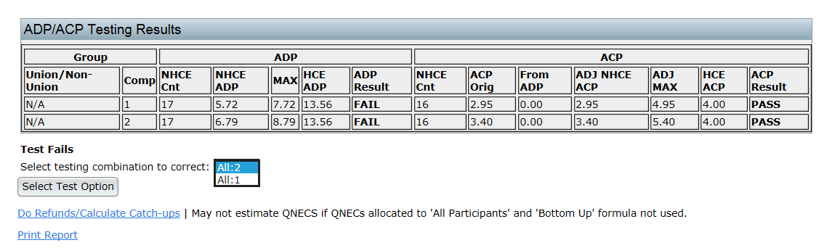
ADP/ACP Test Results
Choose which compensation to use for corrections
Refunds/Catch-ups or QNEC, if available

Slide 28
ADP/ACP Testing - Troubleshooting
QNEC option not available
  Need to allocate to NHCE only if pro-rata
QNEC allocation different from test correction screen
  Estimate only on correction screen
  When allocated will comply with plan specifications
Notes:
You can control the requirements for getting a QNEC allocation under Plan Specifications/Contribution - it's the last block on that screen. You will need to run the allocation including the QNEC and the plan provisions should be used then, and it should use profit sharing compensation.

Slide 29
ADP/ACP Testing - Troubleshooting
Problem with disaggregation
  May need to check dates eligibility for disaggregation is met
Match not included in test
  Allocation parameters must be set before scrub is run – important when uploading match
  Match compensation need to be populated

Slide 30
After-Tax Source
Plans allowing after tax contributions
  Match and after-tax contributions are tested together for the ACP test and for coverage
  Eligibility for after-tax means a participant is considered to be benefitting for coverage, even if they do not receive match

Slide 31
Vendor Updates
Ftwilliam.com recently held webinars with ING and John Hancock
  Recordings and/or slides are available
ING/ftw batch download/upload is available
John Hancock/ftw working on batch features
Lincoln batch download is still available for their ‘Director’ plans but not for ‘TRAC’ system plans – ftw Lincoln v2

Slide 32
Vendor Updates
Lincoln v2, American Funds and Hartford – MFS use the same accounting/reporting software
We have confirmed that their download files now contain a header row which needs to be removed before uploading into ftw
We are working on a fix for these uploads

Slide 33
Vendor Updates
Lincoln Retirement Plan Services – two products:
  Lincoln Webaccess – Lincoln Director product
  web address: www.lfg.com or www.webaccess.lfg.com
  Report – Activity Import Report
  DST TRAC system – Lincoln Alliance product
  web address is www.myplannetwork.com
  Report – Trust Report

Slide 34
Recent Enhancements
Delete Sources & Investments
  To delete a source/account the following must be true:
    Not be in any transaction batch, posted or unposted in current or prior years
First year in plan need to click ‘Show Defaults’ to see sources
Can also use show defaults link to restore default sources, if others were added in error

Slide 35
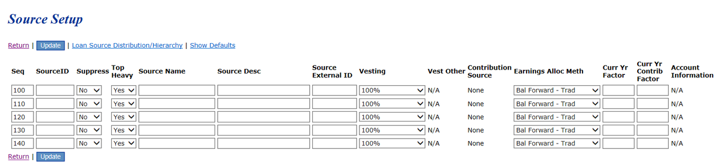
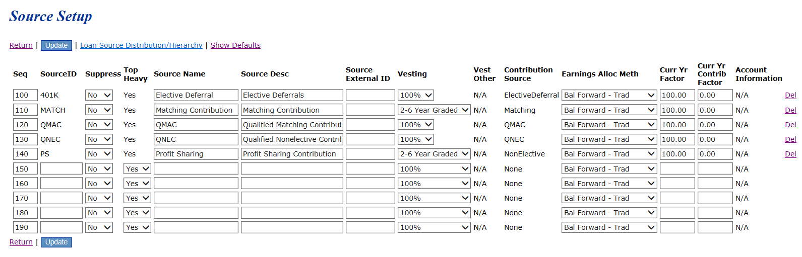
Source Set-up Screen

Slide 36
Loan Module Enhancements
  Link to prime rate added
New field for repayment type
  Select either number of payments or repayment amount
  New field to enter first repayment date
  Edit check added to prevent 1st repayment date more than 3 months from origination date
New field for number of outstanding loans
  Warning if new loan exceeds maximum number
Notes:
New field to enter first repayment date. This adds greater flexibility for loan payment dates. For example, users can enter the first repayment date of 1/15/2014, then select semi-monthly payments and the system will produce the amortization schedule with payments on the 15th and the end of the month.
New edit check added to prevent users from selecting a repayment date that exceeds 3 months from the origination date.
Added a new field to display the number of outstanding loans permitted. The system will produce a warning if the number of loans generated exceeds the maximum amount.
Link to prime rate added. Click the "Look up prime rate" link to have a new window jump to BankRate.com to view the current prime rate.
New field to enter the repayment amount. Now users can select either the number of payments or a specific repayment amount and have the system calculate the amortization schedule based on the criteria entered in the system.

Slide 37
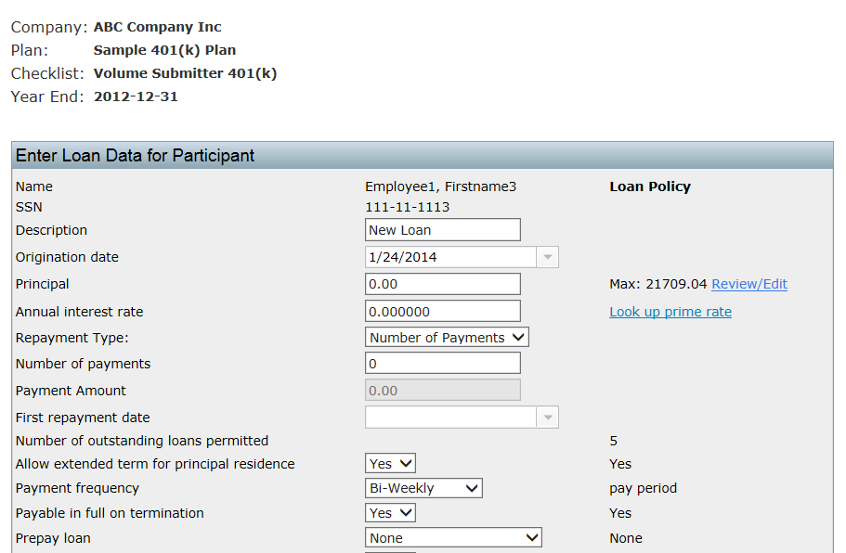

Slide 38
Loan Module Enhancements
Amortization schedule shows subtotals by plan year
New option to choose a date range to post repayments
New annual loan report – shows:
  Beginning balance
  New loan amount
  Interest amount
  Total repayments
  Amount distributed
  Ending balance

Slide 39
New Vesting Export Reports
Original report still available
Additional report includes:
  Hire & termination history
  Service history
Both reports can be run for a single plan or all plans
Scrub & statements both need to be run for vesting to be accurate

Slide 40
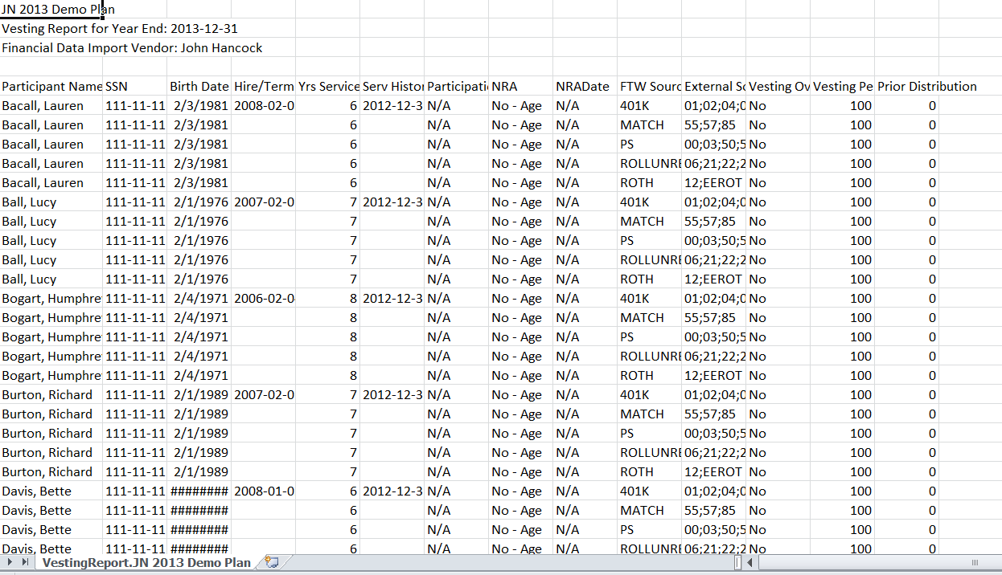
New Vesting Detail Report

Slide 41
Open Forum
Next meeting – Tuesday, April 1, 2014
Ideas for future agenda items?
Questions, ideas, suggestions…..
Thank you for attending!
41

