Slide 1
ftwilliam.com Compliance User Group Meeting
Tuesday November 1, 2016

Slide 2
Agenda
Reminders for year-end
Complete 2015
Adding the new year-end
Download worksheet to send to client
Options for Compliance and Portal users
Census options
Questionnaire options
Bringing forward portal users
Updates
Open Forum

Slide 3
Reminders for Year-end

Slide 4
Reminders for Year End
Preparation – before adding 2016, make sure 2015 is clean & complete
Data Scrub is run
ADP/ACP tests are run if prior year testing method
Top Heavy test is run
Unless you are only using unadjusted transaction data from a vendor, add an ending balance batch on the transaction menu and post
Run statements or one of the vesting export reports
To use loan module or miscellaneous tasks

Slide 5
suggestions
Use the Workflow grid (Tools/Settings=>Workflow) to see what tasks have been run on your plans
Run one of the vesting export reports (Miscellaneous=>Miscellaneous Reports) for all plans

Slide 6
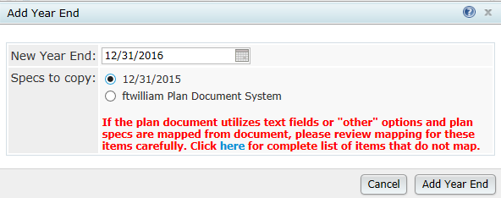
Reminders for Year End
Select ‘Add New Year End’
Default is next calendar or fiscal year
Option to copy plan specs from plan document or prior year on compliance - default is the prior year on compliance

Slide 7
Reminders for Year End
If you do opt to copy specifications from the document they do still need review
Some of the more flexible provisions in PPA documents make some mapping difficult
List of fields to review is available – link in the add new PYE window
Always add year-ends sequentially
Can’t change a year end once added – only option is to delete and re-add
Never add a year that’s earlier than the first year added

Slide 8
Adding plan year ends in batch
Feature is available to all users – you don’t need to use the ftwilliam.com portal
From the compliance module in any plan, go to Tools/Settings and select ‘Batch Add Plan Year End’
Brings up a dialogue box to select the year end to add – defaults to the current calendar year

Slide 9
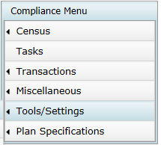
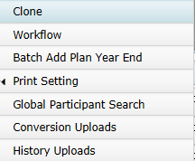
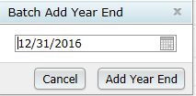
Adding plan year ends in batch
Choose or enter the year end, you’ll see a list of plans to select to the new year end to
The list will include all plans whose last year end is the year before the one entered
E.g. if you use 12/31/2016 you’ll get a list of all calendar year plans that have a 12/31/2015 year end but not a 12/31/2016

Slide 10
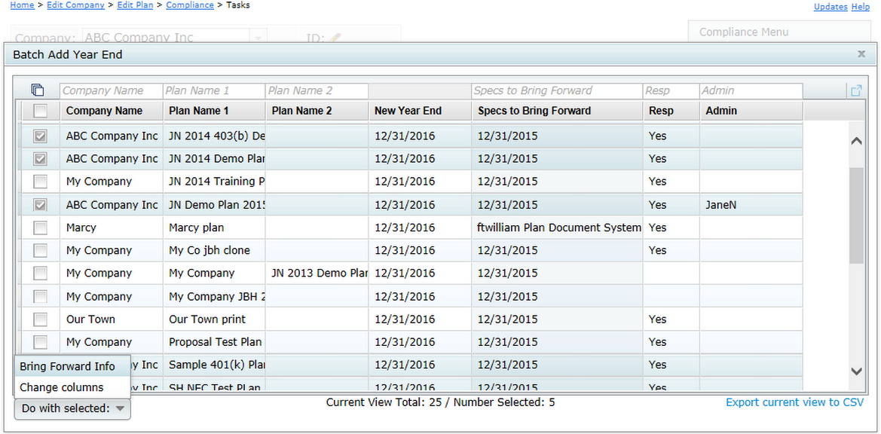
Adding plan year ends in batch
Select some or all plans and use ‘Do with selected’ drop-down

Slide 11
Adding plan year ends in batch
Option to copy plan specs from the previous year in compliance is the default selection
Can change line by line or select the ones to change and use ‘Do with Selected’ button
Select plans and then ‘Change columns’ to switch to copying from the document

Slide 12
Adding plan year ends in batch
To batch add the year-ends, select the pans and click the ‘Bring Forward Info’ option
Confirm the selection

Slide 13
Reminders for Year End
Download census worksheet to send to client for updates
Click ‘Download’ and select ‘Prior
Includes all census data except hours, compensation & contributions
Does not show hire & term dates
Send via portal or other secure method

Slide 14
Reminders for Year End
When uploading the census, option for year two & later on upload screen to copy the fields from prior year OR upload with the census
The System default is Yes, i.e. copy from prior year even if there’s different data on the census
Ownership %
Family Group
Family Group Relationship
Officer status
New Comparability Group
Employee Class
Employee Class Other

Slide 15
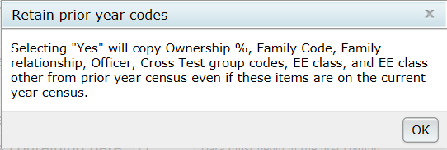
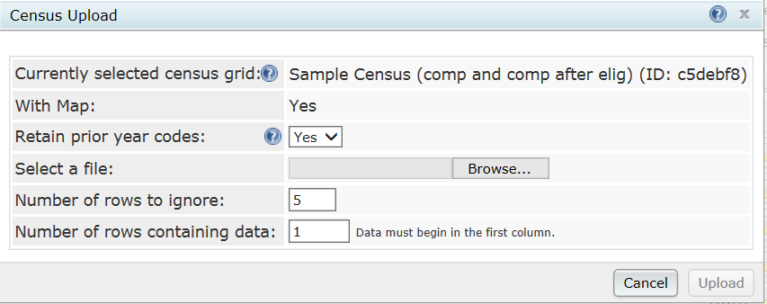
Reminders for Year End
Don’t forget!!

Slide 16
Reminders for Year End
Second and subsequent years should not need to use overrides for eligibility, HCE etc.
If using employee number rather than SSN, the EE# must be consistent from year to year
Cannot switch between SSN & EN
Avoid using dummy SSNs
If uploading employer contributions remember to set overrides on Allocation Parameters screen before running the Data Scrub
2016 transactions
Add beginning balance batch on transaction menu and post unless you plan to import this data from the vendor

Slide 17
Reminders for Year End
Sample EOY checklist is available in the Help Center under ‘Miscellaneous’
Access the Help Center from the ‘Help’ link at the top right of any screen in the compliance module
Please review the check list and let us know suggestions to improve it

Slide 18
Options for Compliance and Portal Users

Slide 19
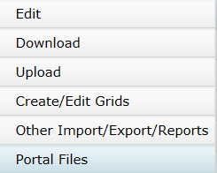
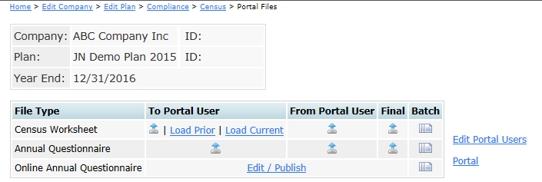
Using the portal files screen
From Compliance menu select Census=>Portal Files
Census Worksheet & Annual Questionnaire files can be exchanged with client
Online Annual Questionnaire can be edited & published

Slide 20
Census Worksheet Options
To Portal User – TPA can post census worksheet for client to access
Load Prior option adds last year’s census file without hours, comp etc.
Load Current typically adds blank spreadsheet
Manual option allows TPS to upload a custom file
From Portal User – TPA can access updated worksheet
Option to ‘Make Final’ and upload in a single click
Batch options also available – need ‘Specify a Server email setting

Slide 21
options for census upload
Former or current year census is also a batch level option
One choice per batch, can’t have some of each in a single batch
Option to upload a custom spreadsheet is still available either plan by plan or within a batch
Additional fields to filter and order by are available within the batch census upload
Notes:
the year that appears on the add census is the first yr without a census file in the portal. So if the plan has several years in ftw but never used the portal the user may need to do some clean up to get to the desired year (2016) to appear. We suggest doing batches and loading a blank file for the past years.

Slide 22
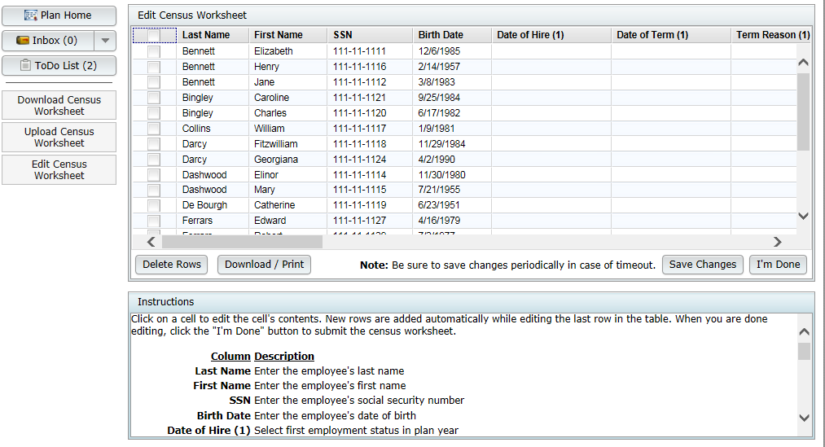
Portal User View of Editing Census

Slide 23
Questionnaire Options
Manually upload your own questionnaire to portal
Use Online Annual Questionnaire (OAQ)
Edit plan by plan or customize a default questionnaire
Re-order questions, import new questions, determine range of answers
Add ‘Plan questions’ – populate from checklist
Publish to portal for client to access and fill out

Slide 24
Editing the Online Annual Questionnaire
Edit the default version, either:
From the Portal Files screen in an individual plan or
From the WK button => Administrative Tasks => Defaults
Any changes saved will impact the default version available for all users
Can always reset to original default version
Above options are available to designated ‘Admins’ only

Slide 25
Default Online annual questionnaire
Global option on Default OAQ screen - ‘Prior Year Default Q & A’
Will be checked unless user unchecks
If checked, and the plan has a prior year OAQ, this will be brought forward to the new year, with answers
If not checked the default OAQ will pull in
Batch options – when you create an OAQ batch and add plans, you’ll see an indictor for each plan as to whether the OAQ is a custom questionnaire or the default

Slide 26
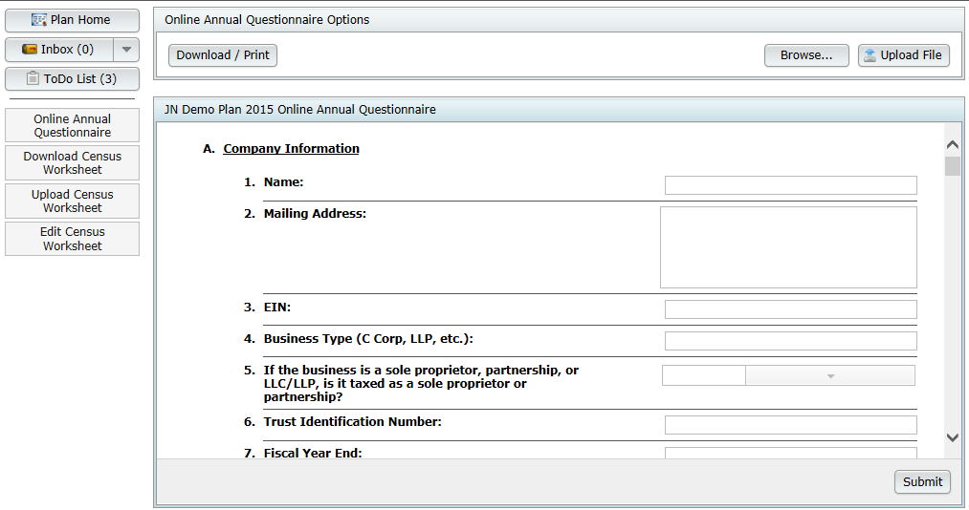
Portal User View of OAQ

Slide 27
Other Options on Portal Files Screen
Edit Portal Users – change permissions, view user portal
Portal link – to main portal home page
Invite to portal – generate email

Slide 28
Bring forward portal users
Plan by plan or in batch
Do this before adding the plan year end, OR after
Only brings users forward if there are none already added
To do, go to the portal screen for any plan
Links on the Portal Users box: ‘Bring Forward Portal Users’ and ‘All Plans’
Bring Forward Portal Users will pull in PUs from prior year for the compliance module only
PU permissions also will be brought forward
Click the ‘Manage User’ link to change permissions

Slide 29
Bring forward portal users
‘All Plans’ link brings up a dialogue box where you select a target year end
Plans with the year prior to that year end will be included, or the year prior and the year
E.g. select 12/31/2016 – list will include plans whose last year end is 12/31/2015 and plans whose last year end is 12/31/2016 and also have a 12/31/2015 YE
Click the ‘Bring Forward’ button
See a window listing all the plans potentially having a portal user added with results for each
Shows number of plans and number portal users brought forward

Slide 30
Updates – emails coming soon.
Cash Balance Plan administration feature
Davis Bacon Plans
New grid *ftw Davis Bacon
Procedures
Portal tools

Slide 31
Open Forum
Next User Group meeting – Tuesday, December 6, 2016
Ideas for future agenda items?
Questions, thoughts, suggestions…..
Happy Turkey Day and thank you for attending!

